Slide 1
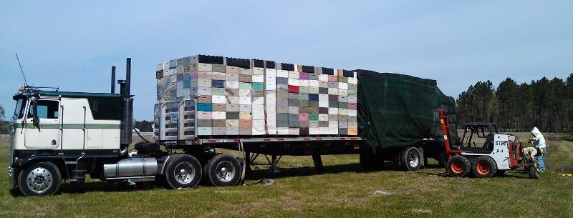
Homesick: impacts of migratory beekeeping on honey bee disease and colony health
---
Samantha Alger, P. Alexander Burnham, Zac Lamas, Alison K. Brody, & Leif Richardson
keychainlogistics.com

Slide 2


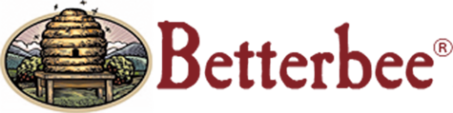


Acknowledgments
Jeff Lee, Lees Bees, Mebane, NC
Kendall Eppley
Greer Sargeant
Nora Keathley
Gracia Archeson

Slide 3
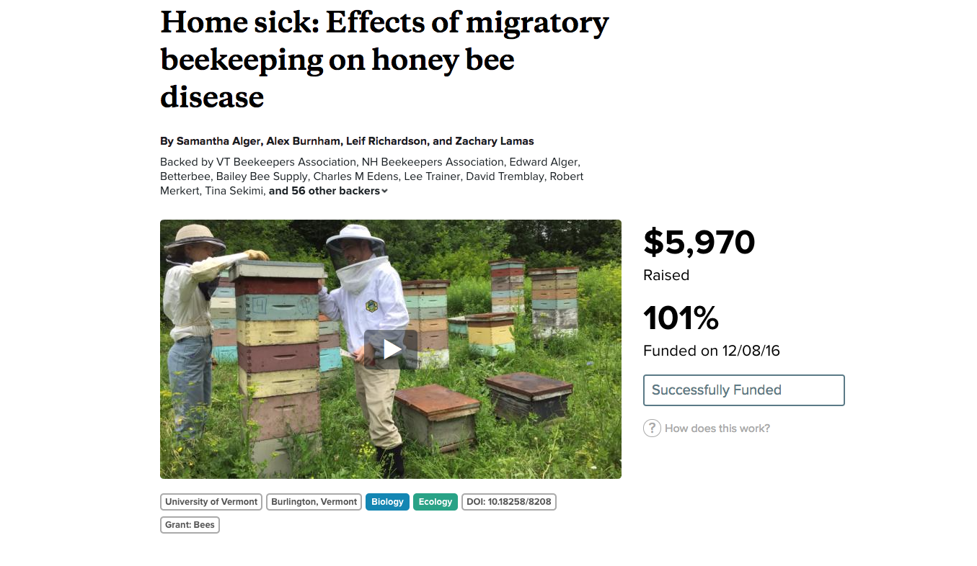
www.experiment.com/beekeeping

Slide 4
And Most of all, our Backers…
VT Beekeepers Association, NH Beekeepers Association, Edward Alger, Betterbee, Bailey Bee Supply, Charles M Edens, Lee Trainer, David Tremblay, Robert Merkert, Tina Sekimi, Mike Kiernan, Sandra Tomlinson, Amy Handy, Joe Perry, Luke Manlove, Dan Boisvert, Jacqueline Alger, Dan O'Hanlon, Patrick Gillen, Alison K Brody, Daniel Hall Lipke, Beth Sawyer, Cathy Wilson, Allison Malloy, Richard Reid, Nicole Berthiaume, Heather Achilles, Phyllis E Burnham, Yeager Anderson, Bill Castro, Luke Tilley, Jonathan Alger, Peter Gatehouse, Amy Parachnowitsch, Trevor Brandt, Katie Iles, Jessica Pagano, Kate Protagonist, Andrea Stanley, Robert Zywno, Helmut Besser, Allen Turechek, Adrian Adam Zywno, Kirsten Shoshanna Traynor, Meghan O'Rourke, Jean McCartin, Ben Ritchie, Vicki Anne, Hollis Woodard, James DeRosia, The Backyard Farm, Malcolm Hobbs, Aaron Schwartz, Linda Battista, Lauren Ash, Raphaël Royauté, Kay Newhouse, Maggie Davern, Joanne Bryan, Sarah Rommelfanger, Pureum Kim, Luke McCartin, Kendall Johnson, Sara Held, Eric Damon Walters, and Bo Sprotte Kofod

Slide 5

esa.org
Notes:
Bees are important for both the pollination of our wild plants and agricultural crops. Without them, our fruit and vegetable choices would be very limited. Here’s a picture depicting our grocery stores without the pollination services of bees.

Slide 6
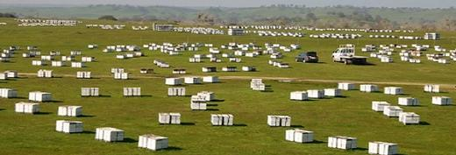
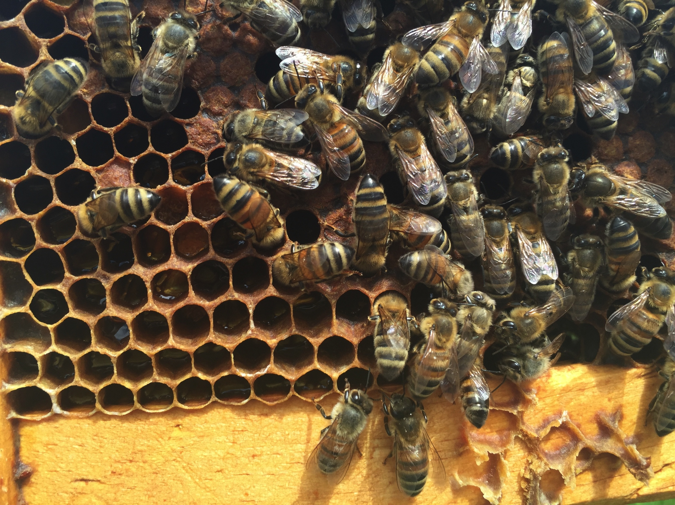
US Beekeepers lost 44%
of their bees in 2015-16
-Beeinformedpartnership.org
Notes:
And evidence is accumulating of spillover from managed bees to wild bees.

Slide 7
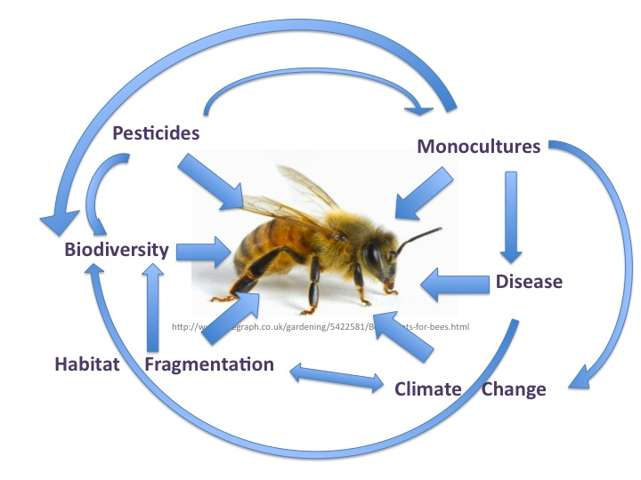
Notes:
The decline of pollinators has risen to public awareness and there are many threats affecting bees.

Slide 8
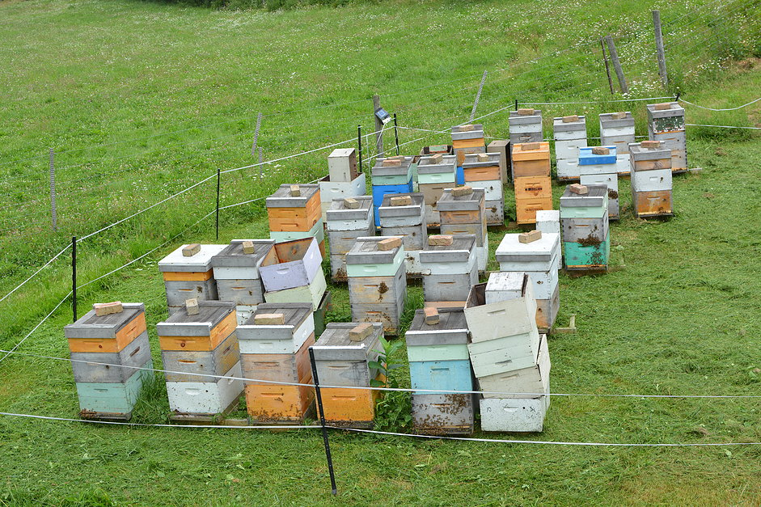
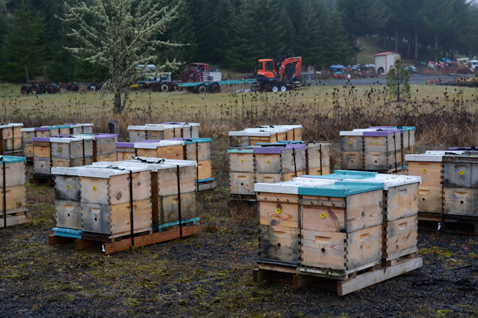
Two Main Types of Apiaries…
Stationary
Migratory
vs.
bedillionhoneyfarm.com
waywardspark.com

Slide 9
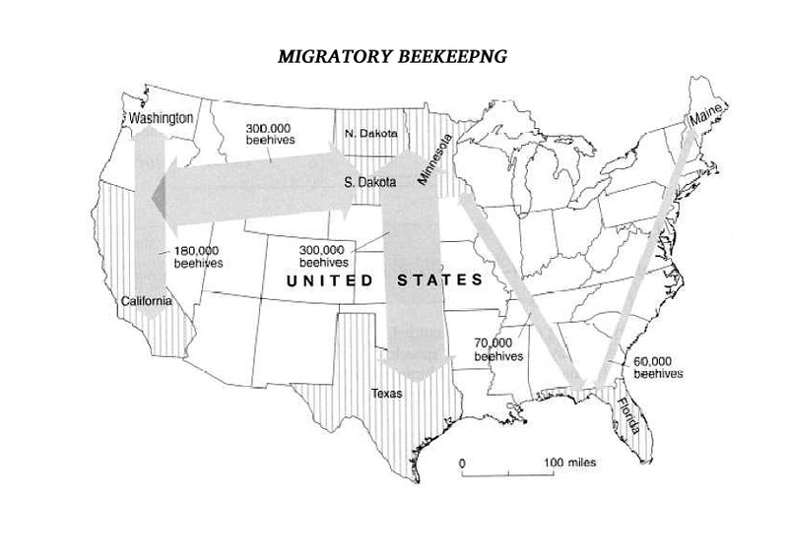
Migratory
Pollination Contracts
Almonds
Citrus
Blueberries
~60% of US colonies pollinate almonds
$14.6 billion industry
(Cavigli et al., 2016)
(Morse & Calderone, 2000)

Slide 10
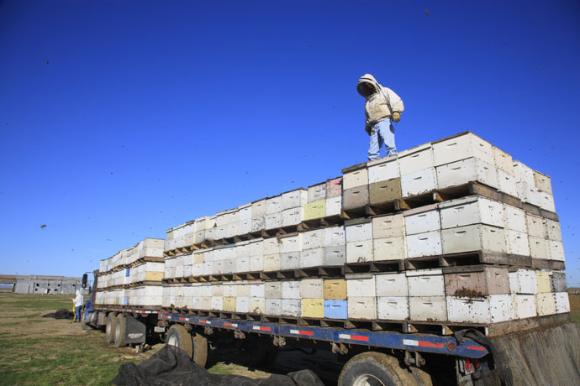
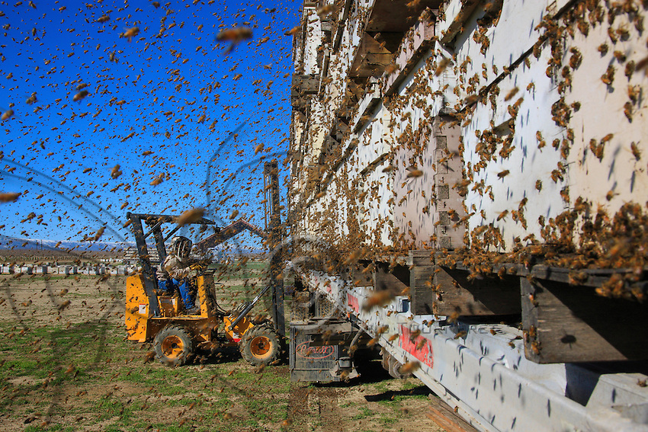

Slide 11
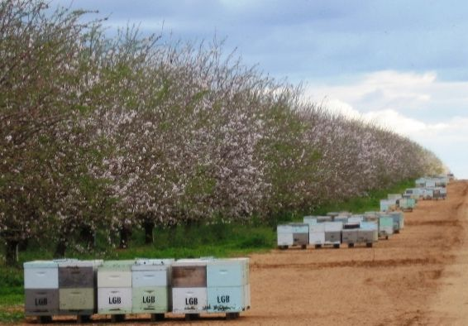
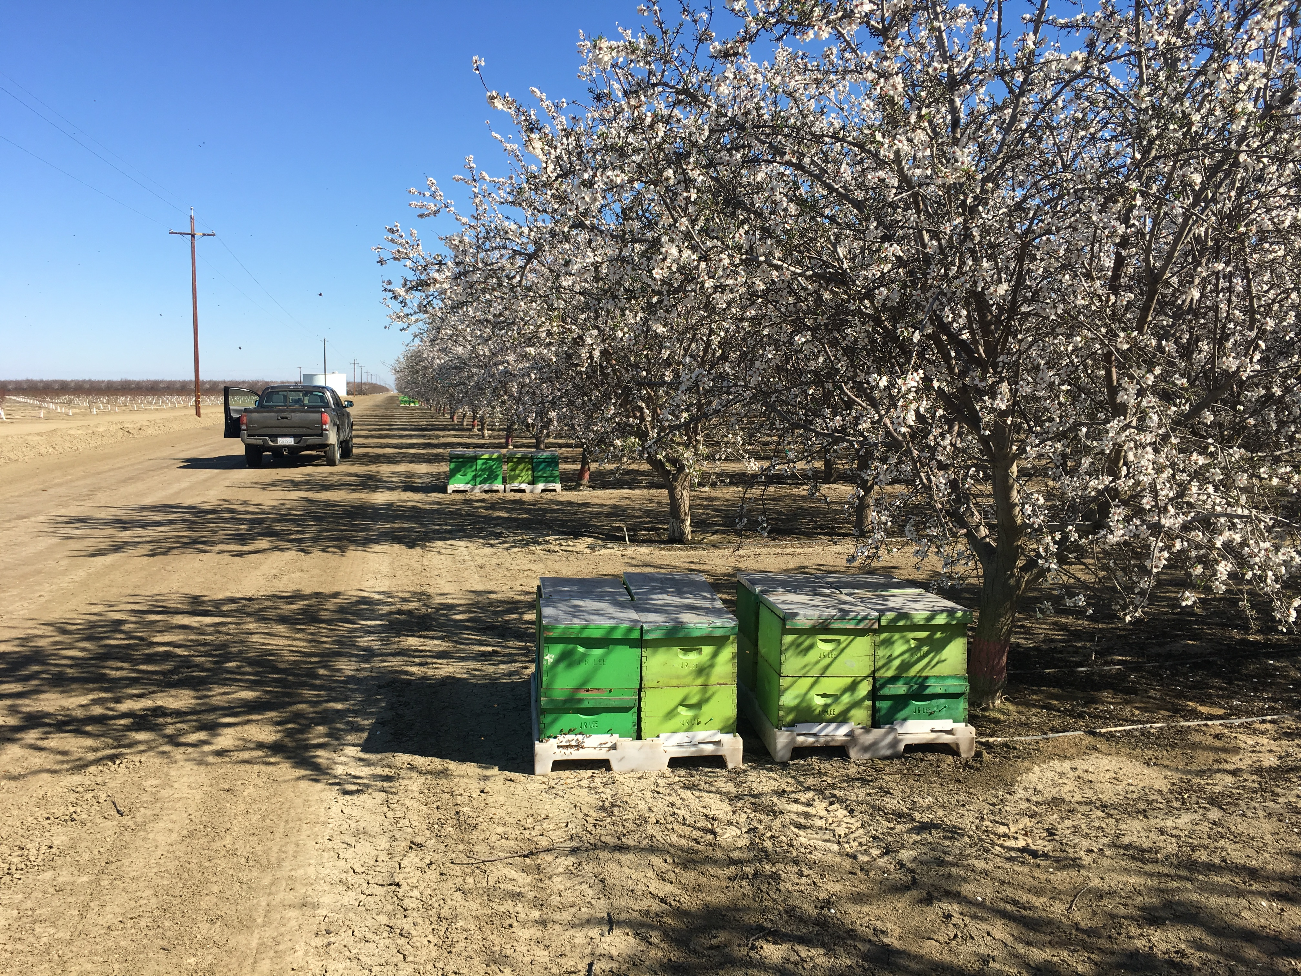
Notes:
Each acre of almonds requires an average of two honey bee colonies [21] and as bees will forage 3 km from their colonies [23–25], bees in large orchards could theoretically share flowers with bees from nearly 56,000 other colonies.

Slide 12

Notes:
While there are a lot of almond flowers, there is little diversity.. This is a

Slide 13
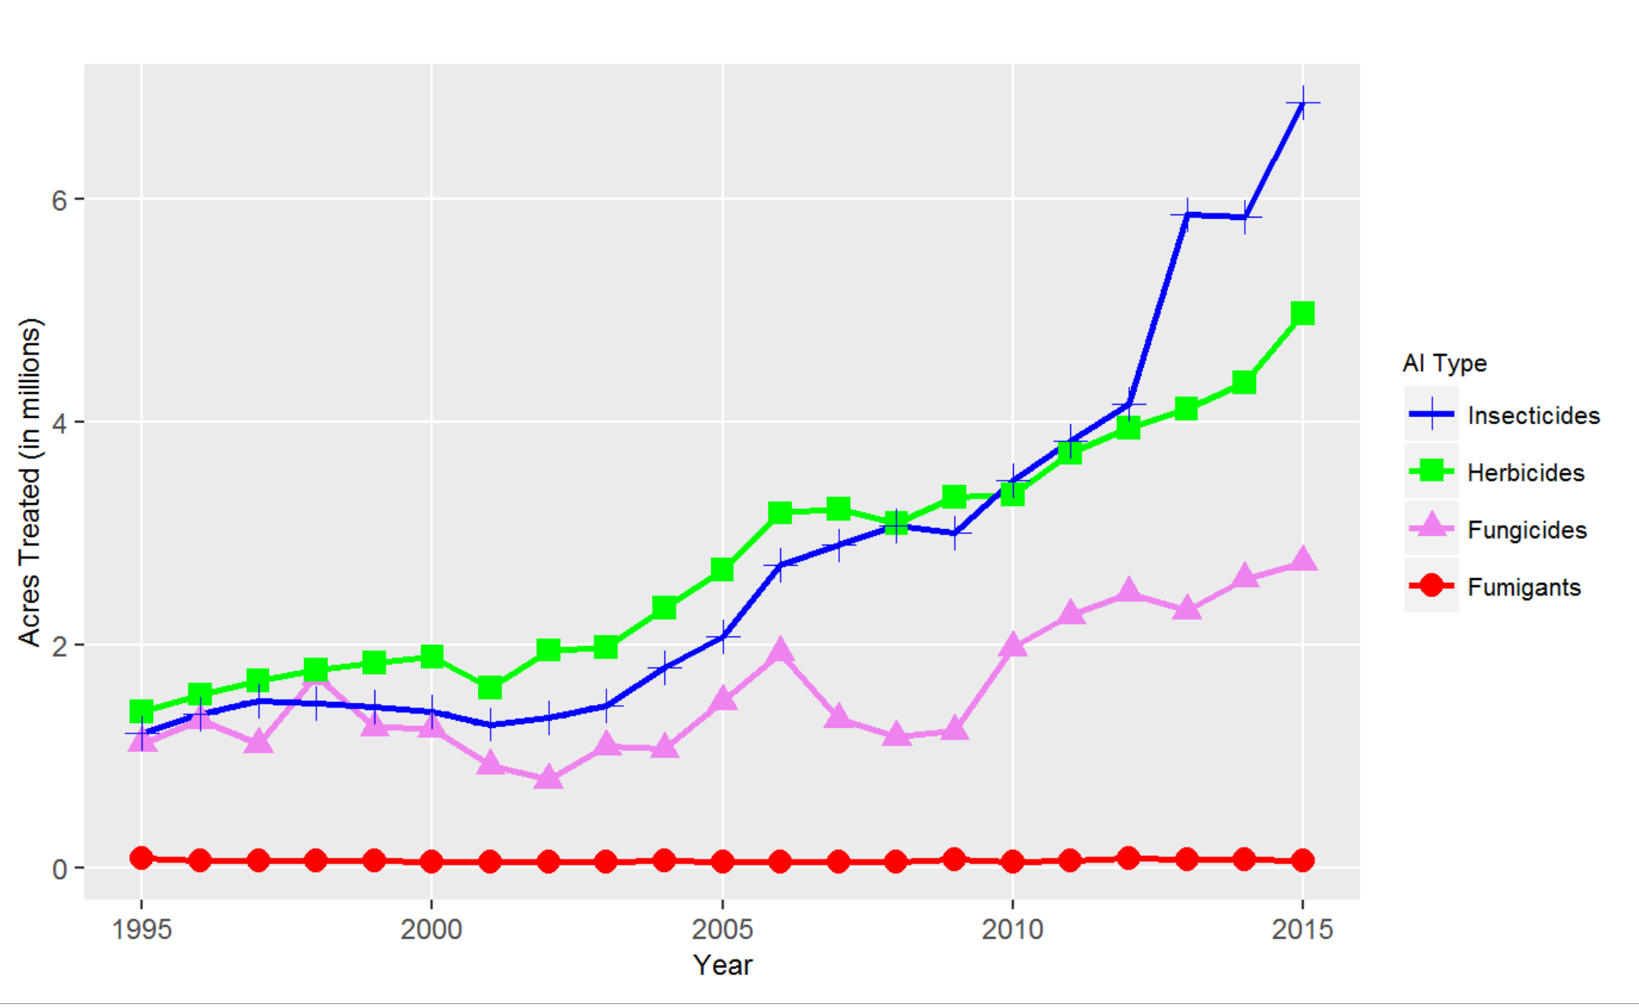
Over 35 million lbs. of active ingredients applied to CA Almonds in 2015
California Department of Pesticide Regulation
Notes:
In California, almonds receive the greatest amount of pesticides of all treated crops and according to the most recent report, there was a 25 percent increase in total amount of pesticides applied in 2015
Studies have shown there are synergistic effects of pesticide exposure and diseases.

Slide 14
The big question!
“Are migratory honey bee colonies more likely to host pathogens?”

Slide 15
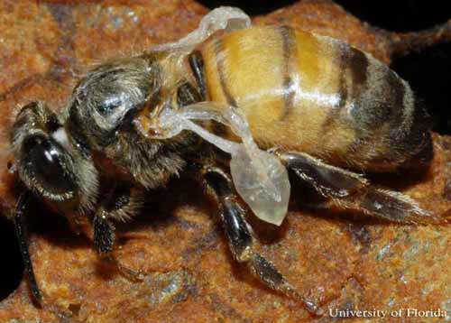
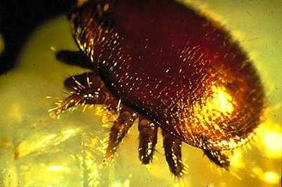
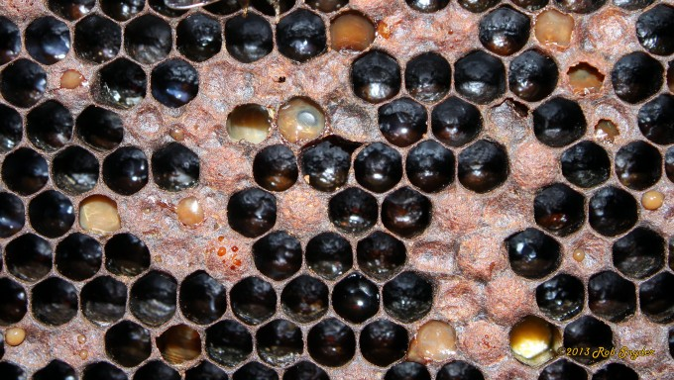
Honey Bee Pathogens:
VIRUSES:
Deformed Wing Virus (DWV)
Black Queen Cell Virus (BQCV)
Israeli Acute Paralysis Virus (IAPV)
PARASITES:
Nosema (ceranae & apis)
Varroa Mite
OTHER PATHOGENS & Pests:
American Foulbrood (AFB)
European Foulbrood (EFB)
Chalk Brood
Small Hive Beetle
Deformed wing Virus
University of Florida,
Entomology Dept.
Varroa destructor
North Carolina State University,
Cooperative Extension
American Foulbrood
Bee Informed Partnership

Slide 16
Previous work…
Migratory operations:
Host novel virus strains
Have high disease loads
(Runckel et al., 2011)
(Welch et al., 2009)

Slide 17
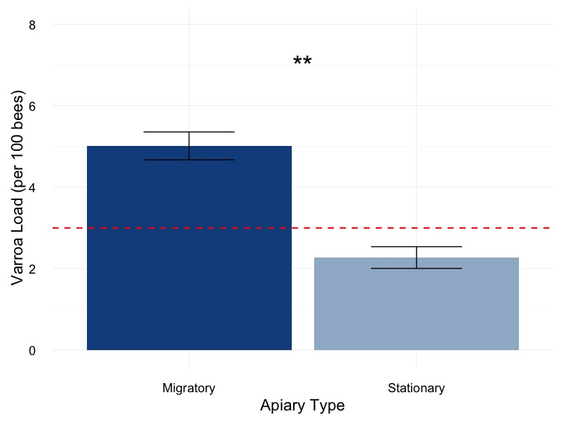
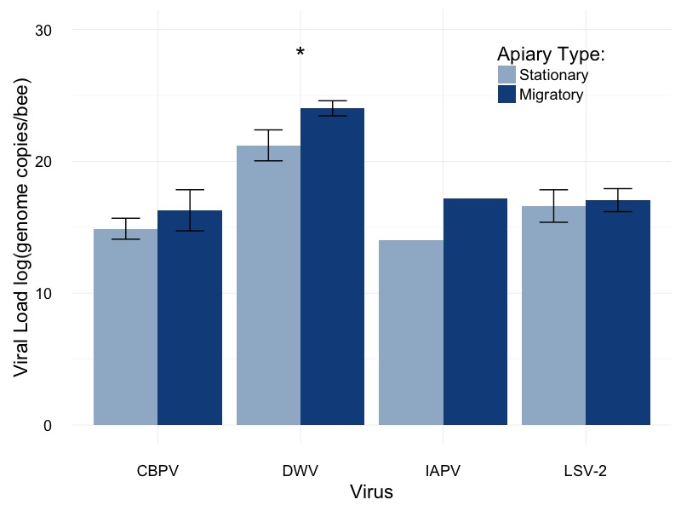
Preliminary Data from VT National Honey Bee Survey
Varroa Mites:
RNA Viruses:

Slide 18
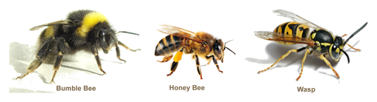
Previous work…
Wild bees near managed apiaries with high virus loads are more likely to be infected with viruses
(Alger et al., in prep.)

Slide 19
Two parts to this experiment:
Part I: Do migratory colonies have higher pathogen levels than stationary colonies?
Part II: Can migratory colonies infect stationary colonies upon their return?

Slide 20
Experimental Design
Three groups of colonies:
Migratory
Stationary (control)
Stationary (exposed)
Each group contained 16 colonies
Sampled at three different times

Slide 21
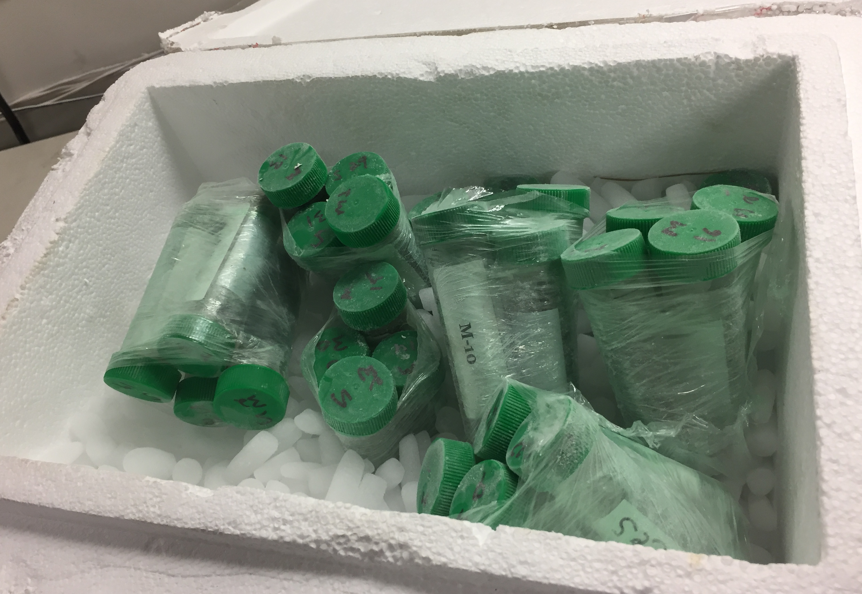
Experimental Design
Field inspection:
Common brood diseases
Frames of bees
Laboratory Analysis:
Varroa load
Nosema load
Viruses: DWV, BQCV, IAPV

Slide 22



Experimental Design for Migratory/Stationary Honey Bee Experiment Part I
CA
NC
Migratory Group
Migratory Group
Stationary Group
- Do migratory colonies have higher pathogen levels than stationary colonies?
Notes:
Sampled, End of January- sent to Almonds for a month, brought back to NC and resampled. Waited one month and sampled a third time.

Slide 23
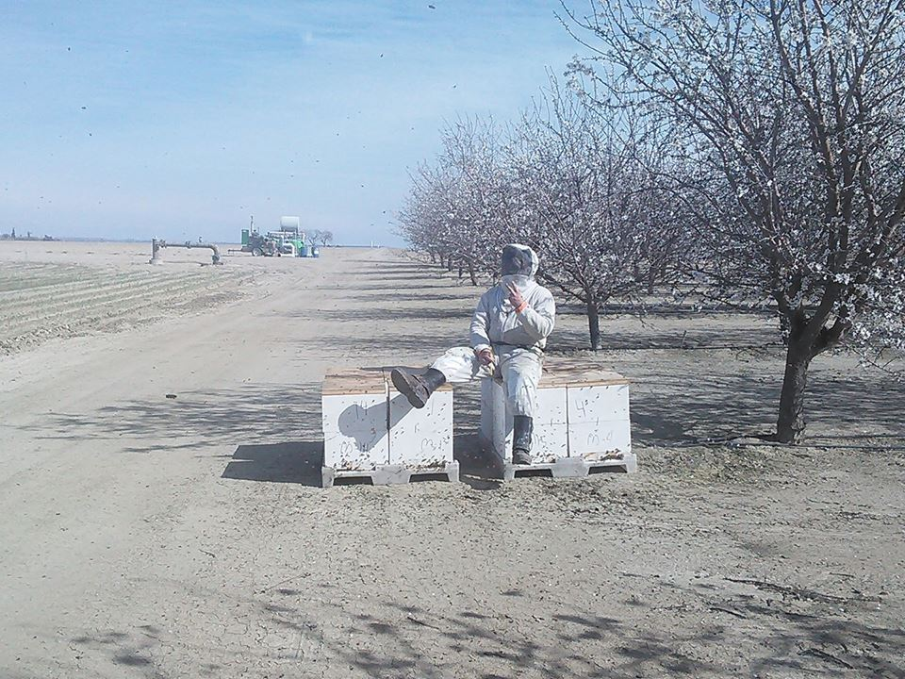

Slide 24
Do migratory colonies have higher pathogen levels than stationary colonies?
Part I: Results

Slide 25
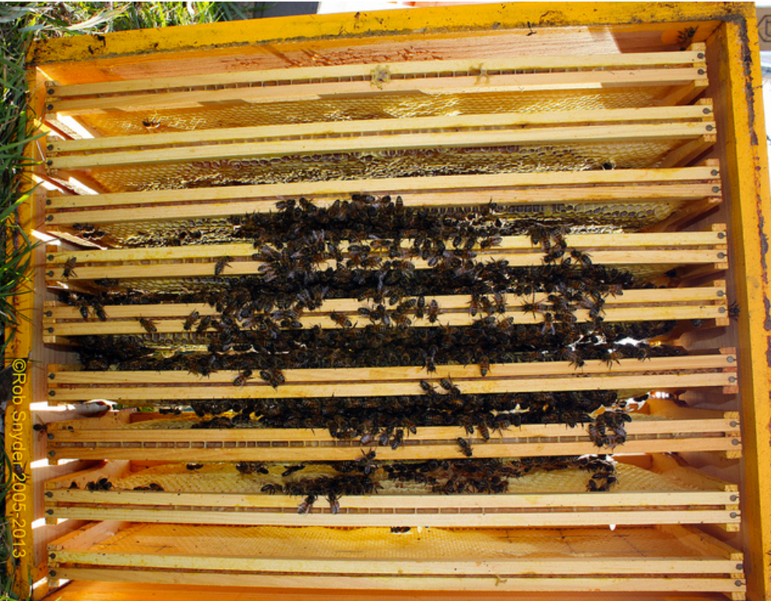
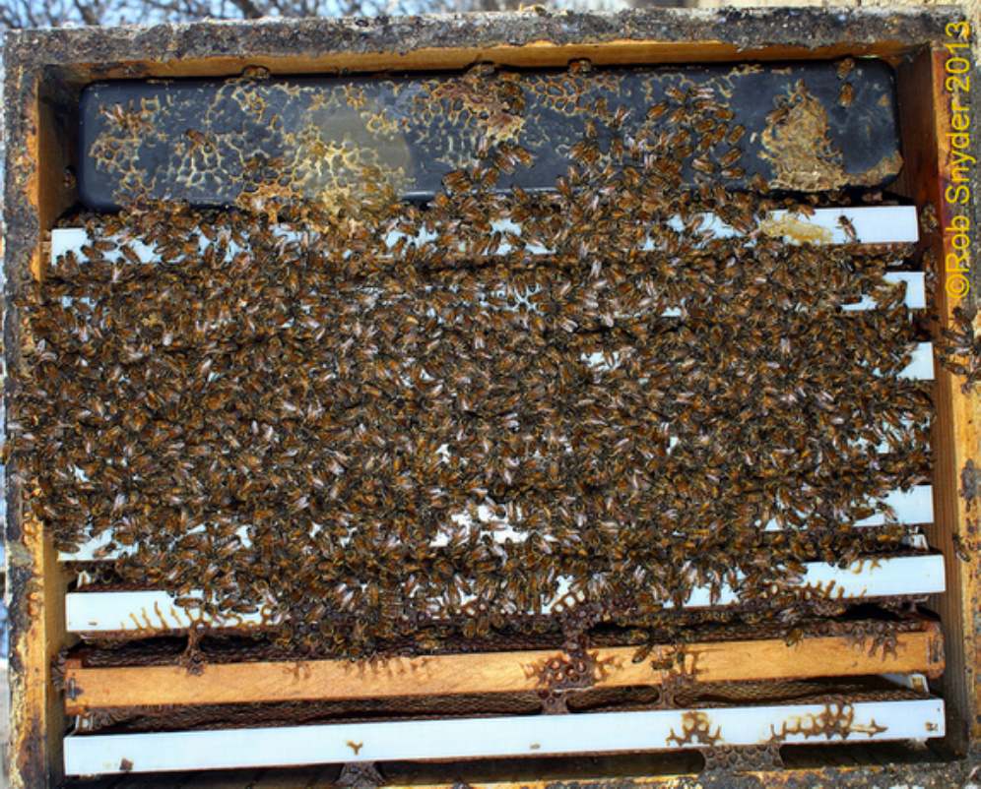
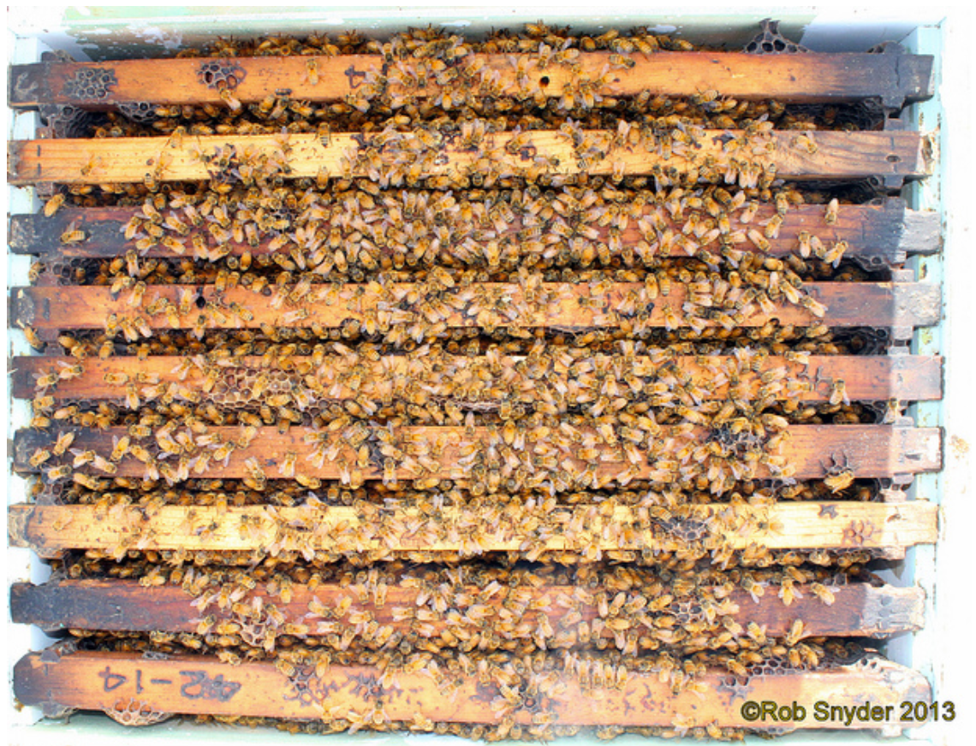
Part I: Results Frames of Bees
1.5 Frames
5.5 Frames
8 Frames
BIP Tech Transfer Team Protocol Manual

Slide 26
Part I: Results Frames of Bees
(Alger et al., in review)
Notes:
Could be stress related.
We believe there was a loss of foragers during the move for the migratory hives.

Slide 28
Part I: Results Varroa load
(Alger et al., in review)
Notes:
Lower Varroa in migratory: Previous studies found lower mite loads in migratory hives and hypothesized that this was due to the bumping around while on the road in the truck. This was not the case in our study- as you see varroa loads similar right when the bees returned at time step two. However, we do see a crash in the Varroa population at time step three. We believe this could be due to the lower bee population present in the hives after the stress of the move. Since we know that Varroa populations mirror the populations of the bees in a hive.

Slide 29

Bayer

Slide 30
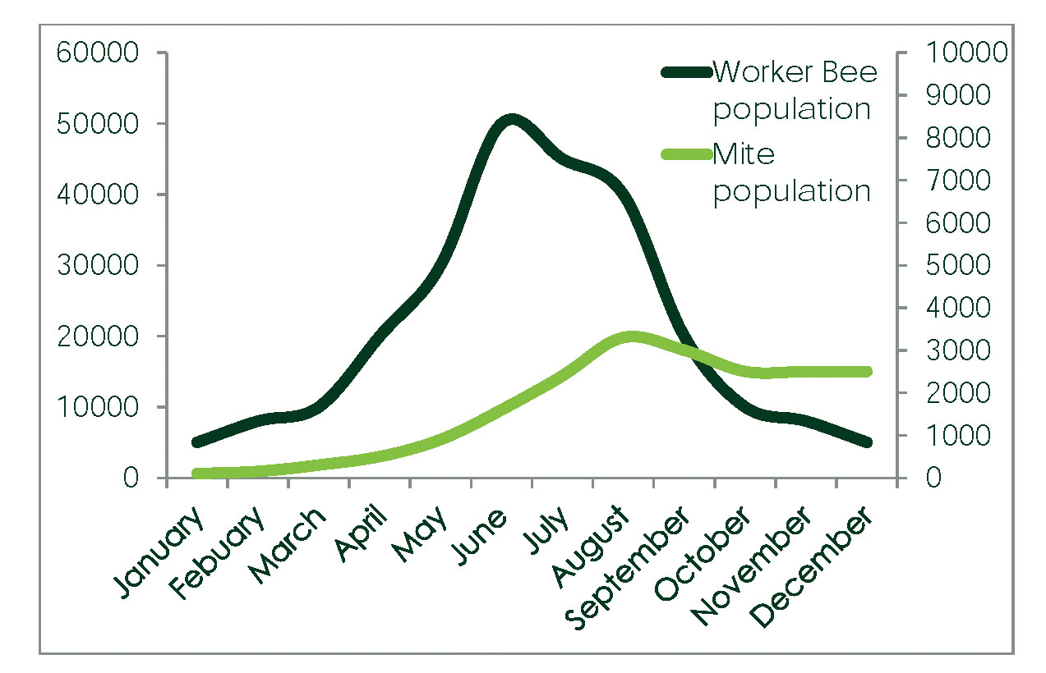

Slide 31
Part I: Results Deformed Wing Virus Load
(Alger et al., in review)

Slide 32
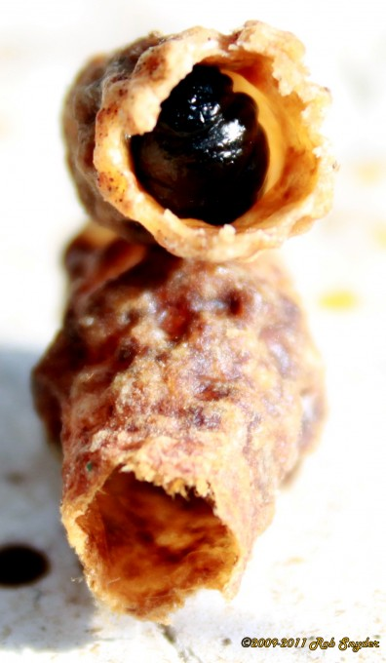
Part I: Results Black Queen Cell Virus Load
(Alger et al., in review)
Notes:
Migratory came back with higher BQCV loads- either due to stress or exposure in the almond fields.

Slide 33

Organosilicone surfactant adjuvants (OSS) exposure results in higher BQCV titers
CA almonds -> Hundreds of thousands of lbs./year
Fine et al., 2017, Scientific Reports
California Department of Pesticide Regulation
Notes:
Hundreds of thousands of pounds of OSS formulas are used in California almonds each year, often during bloom.

Slide 34
Part I: Summary
Compared to Stationary hives Migratory hives had:
Fewer frames of bees
Lower Varroa loads
Higher BQCV loads
Similar DWV load
No IAPV detected

Slide 35
Can migratory colonies infect stationary colonies upon their return?
Part II:

Slide 36
Experimental Design for Migratory/Stationary Honey Bee Experiment Part II
CA
NC
Exposed Group
Stationary Group
(Control)
Migratory Group
- Can migratory colonies infect colonies upon their return?

Slide 37
Can migratory colonies infect stationary colonies upon their return?
Part II: Results

Slide 38
Part II: Results Frames of Bees
(Alger et al., in review)

Slide 39
Part II: Results Varroa load
(Alger et al., in review)

Slide 40
Part II: Results Deformed Wing Virus Prevalence
(Alger et al., in review)
Notes:
One month after the introduction on the migratory hives, we see an increase in DWV prevalence in the exposed group.

Slide 41
Part II: Results Deformed Wing Virus Load
(Alger et al., in review)

Slide 42
Part II: Results Black Queen Cell Virus Load
(Alger et al., in review)
Notes:
We see a converging of the BQCV loads, where the migratory hives are converging to the levels of the other two groups. It appears that migratory conditions increased the viral loads, but did not appear to affect the exposed group.

Slide 43
(Alger et al., in review)

Slide 44
Part II: Summary
Compared to the Stationary (Control) hives, Exposed hives had:
Higher DWV load and prevalence
More frames of bees
Similar BQCV loads, Varroa loads, Brood pattern
No IAPV detected

Slide 45
Overall Summary
Negative effects of migratory conditions: Reduced bee population
Increased BQCV load
Positive effects of migratory conditions:
Reduced Varroa load
The DWV load increased in the exposed group after one month foraging alongside the migratory group.

Slide 46
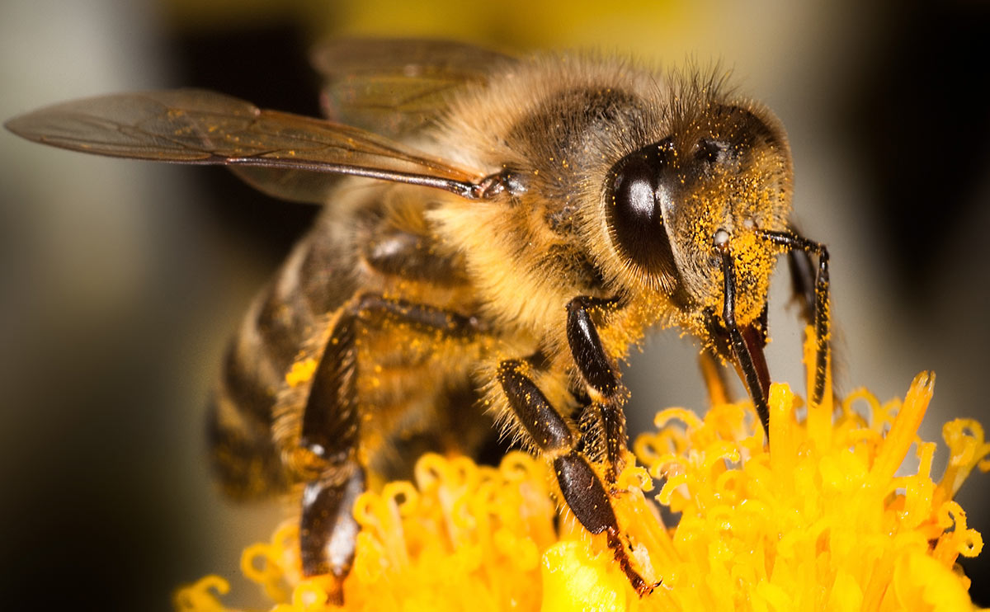
Thank You!

Slide 47
Questions?

Slide 48
Part II: Results Deformed Wing Virus Load
Within the colony transmission
Increases with higher bee populations and higher Varroa loads (DWV vector)
Between colony transmission
Increases with higher colony density
Notes:
We also see an increase in DWV load. Why is this? we know that varroa are vectors for DWV. And that the bee population is tightly linked to Varroa population such that as bee population increases, so does varroa and DWV load. We believe that once the migratory colonies returned, this increased the opportunity for disease transmission. Since the exposed group had a healthy bee population and increasing varroa load at the time of exposure, conditions were ripe for the transmission and replication of DWV. In addition, we do not yet know if we are looking at different strains of DWV. It is possible that the migratory colony brought back a more virulent strain that is taking advantage of the increasing mite loads and large bee population of the exposed group. Further molecular testing would help to answer this question.

